Slide 1
SQL Programming Tutorial Bootcamp
INFORMS at USF
March, 2016
Iman Nekooeimehr

Slide 2
Outline
An overview of the SQL system
Create SQL data set
Combining SAS data sets and Match merging SQL Data Sets
Formatting data
Introduce some simple regression procedure
Summary report procedures

Slide 3
What is SQL
Structured Query Language
Developed by IBM in the early 1970’s.
A standard of the American National Standards Institute (ANSI) in 1986, and of the International Organization for Standardization (ISO) in 1987.

Slide 4
SQL in SAS
In 1987 database interface for SQL was added to the Version 6 Base SAS package
A “language within a language”.
Designed for managing data held in a relational database management system (RDBMS)

Slide 5
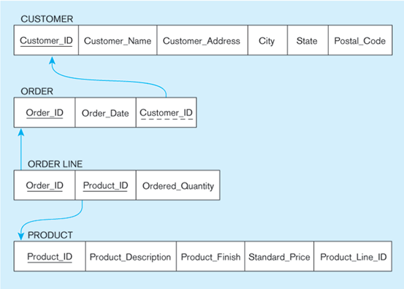
Relational Database

Slide 6
General Tips on Learning any new Programming Language
Data Types
Import and Export Data
Loops
If conditions
Functions

Slide 7
Data Types in SQL
Characters: CHAR(20), VARCHAR(50)
Numbers: INT, BIGINT, SMALLINT, FLOAT
Others: MONEY, DATETIME, …

Slide 8
How to Create a Dataset using SQL
proc sql;
create table BcampLib.Order
(Order_ID int,
Customer_ID int,
Order_time num format=date7.,
Ordered_Quantity num);
insert into BcampLib.Order
values(1,1,'26JUN14'd,123)
values(2,3,'26JAN15'd,24)
values(3,7,'05NOV15'd,245)
values(4,6,'30NOV12'd,234)
values(5,10,'07OCT87'd,35)
values(6,2,'15APR14'd,453)
values(7,3,'23DEC15'd,23)
values(8,6,'30JAN16'd,54);
title 'BootcampLib.Order Table';
select *
from BcampLib.Order;
proc print; run;

Slide 9
Keywords in SQL
SQL is a language build on a very small number of keywords:
SELECT columns (variables) that you want
FROM tables (datasets) that you want
ON join conditions that must be met
WHERE row (observation) conditions that must be met
GROUP BY summarize by these columns
HAVING summary conditions that must be met
ORDER BY sort by these columns

Slide 10
Anatomy of A PROC SQL Statement
PROC SQL;
SELECT column list
FROM table list
WHERE condition list
GROUP BY column list
ORDER BY column list
;
quit;

Slide 11
Examples
PROC SQL;
SELECT Order_ID, Order_time
FROM BcampLib.Order;
QUIT;
PROC SQL;
SELECT Order_ID, Order_time
FROM BcampLib.Order
WHERE Ordered_Quantity > 150;
QUIT;

Slide 12
More Examples
PROC SQL;
SELECT Order_ID, Customer_ID, Order_time
FROM BcampLib.Order
WHERE Ordered_Quantity > 100
Order by Customer_ID;
QUIT;
PROC SQL;
SELECT Order_ID, Customer_ID, Order_time
FROM BcampLib.Order
WHERE Ordered_Quantity > 100
Order by Customer_ID Descending;
QUIT;

Slide 13
More Examples II
PROC SQL;
SELECT Distinct Customer_ID
FROM BcampLib.Order;
QUIT;

Slide 14
Aggregation in SQL
SQL supports several aggregation operations:
sum, count, min, max, avg
Except count, all aggregations apply to a single attribute
Example:
PROC SQL;
SELECT count(Distinct Ordered_Quantity)
FROM BcampLib.Order
WHERE Ordered_Quantity > 150;
QUIT;

Slide 15
Grouping and Aggregation
Aggregation without Grouping:
PROC SQL;
SELECT sum(Total_Purchase/LoyYear) as TotAvgPurchase
FROM BcampLib.Customer
WHERE Sex = 'M';
QUIT;
Aggregation with Grouping:
PROC SQL;
SELECT Sex, sum(Total_Purchase/LoyYear) as TotAvgPurchase
FROM BcampLib.Customer
Group by Sex;
QUIT;

Slide 16
HAVING Clause
HAVING clause contains conditions on aggregates.
Example; try with and without the Having clause:
PROC SQL;
SELECT Sex, sum(Total_Purchase/LoyYear) as TotAvgPurchase
FROM BcampLib.Customer
Where Age > 40
Group by Sex
Having sum(Total_Purchase/LoyYear) > 110;
QUIT;

Slide 17
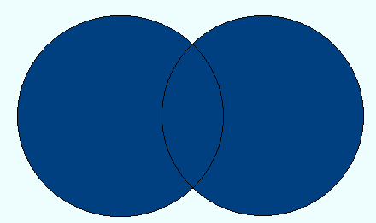



Combining Datasets: Joins
Full Join
InnerJoin
If a or b;
If a and b;
Left Join
Right Join
If a;
If b;

Slide 18
SQL RIGHT JOIN
PROC SQL;
SELECT Order_ID, Order.Customer_ID, Total_Purchase, LoyYear, Sex
FROM BcampLib.Customer
RIGHT JOIN BcampLib.Order
ON Order.Customer_ID = Customer.Customer_ID
ORDER BY Order_ID;
QUIT;

Slide 19
Conditions in SQL
CASE input_expression
WHEN when_expression THEN result_expression [ ...n ]
[ ELSE else_result_expression ]
END

Slide 20
Example of IF Conditions SQL in SAS
PROC SQL;
SELECT *,
CASE
WHEN Ordered_Quantity le 100 THEN 1
WHEN 100 lt Ordered_Quantity le 200 THEN 2
WHEN Ordered_Quantity gt 200 THEN 3
ELSE .
END
AS Quant_Cat format=1.
FROM BcampLib.Order;
QUIT;

Slide 21
Modifying the Database
Three kinds of modifications
Insertions
Deletions
Updates
Sometimes they are all called “updates”

Slide 22
Insertions
General form:
INSERT INTO R(A1,…., An) VALUES (v1,…., vn)
Example: Insert a new purchase to the database:
insert into BcampLib.Order
values(1,1,'26JUN14'd,123)
Missing attribute → NULL.
May drop attribute names if give them in order.

Slide 23
Insertions
INSERT INTO PRODUCT(name)
SELECT DISTINCT Purchase.product
FROM Purchase
WHERE Purchase.date > “10/26/01”
The query replaces the VALUES keyword.
Here we insert many tuples into PRODUCT

Slide 24
Insertion: an Example
Product(name, listPrice, category)
Purchase(prodName, buyerName, price)
prodName is foreign key in Product.name
Suppose database got corrupted and we need to fix it:
Purchase
Product
prodName | buyerName | price
camera | John | 200
gizmo | Smith | 80
camera | Smith | 225
name | listPrice | category
gizmo | 100 | gadgets
Task: insert in Product all prodNames from Purchase

Slide 25
Insertion: an Example
INSERT INTO Product(name)
SELECT DISTINCT prodName
FROM Purchase
WHERE prodName NOT IN (SELECT name FROM Product)
name | listPrice | category
gizmo | 100 | Gadgets
camera | - | -

Slide 26
Insertion: an Example
INSERT INTO Product(name, listPrice)
SELECT DISTINCT prodName, price
FROM Purchase
WHERE prodName NOT IN (SELECT name FROM Product)
name | listPrice | category
gizmo | 100 | Gadgets
camera | 200 | -
camera ?? | 225 ?? | -
Depends on the implementation

Slide 27
Deletions
Example:
DELETE FROM PURCHASE
WHERE seller = ‘Joe’ AND
product = ‘Brooklyn Bridge’
Factoid about SQL: there is no way to delete only a single
occurrence of a tuple that appears twice
in a relation.

Slide 28
Updates
Example:
UPDATE PRODUCT
SET price = price/2
WHERE Product.name IN
(SELECT product
FROM Purchase
WHERE Date =‘Oct, 25, 1999’);

Slide 29
Check SQL
Example:
CREATE TABLE Persons ( P_Id int NOT NULL CHECK (P_Id>0), LastName varchar(255) NOT NULL, FirstName varchar(255), Address varchar(255), City varchar(255) )

Slide 30
Add Primary Key Constraint
Before Creating the Table:
CREATE TABLE Persons ( P_Id int NOT NULL PRIMARY KEY, LastName varchar(255) NOT NULL, FirstName varchar(255), Address varchar(255), City varchar(255) )
After Creating the Table:
ALTER TABLE Persons ADD PRIMARY KEY (P_Id)

